Slide 1
HACKATHON : Finding Hospitals
COHORT: INTQEA21QE017 GROUP :7
Vundela Siva Rami Reddy - 911315
Shaik Kareema Ashmin - 911314
Sareddy Vedantha Kumar Reddy- 911328
Bochala Chris Matthews - 911290
Sheikh Mohammad Saide- 911740

Slide 2
MODULES ASSIGNED
Vundela Siva Rami Reddy -Display Hospitals near which are open 24*7
Shaik Kareema Ashmin -Display Hospitals which has parking Facility
Sareddy Vedantha Kumar Reddy -Display Hospitals with more than 3.5 rating
Bochala Chris Matthews - Display Top cities
Sheikh Mohammad Saide -Handling alert

Slide 3
PROJECT DESCRIPTION
For Bangalore city, identify Hospitals that is Open 24/7, has Parking facility with rating more than 3.5; Display the hospital names
In Diagnostics page, pick all the top cities name & store in a List; Display the same
Go to Corporate Wellness, fill invalid details, schedule & capture the warning message from the alert
Site - practo.com

Slide 4
TOOLS
Eclipse IDE
TestNG
Maven
Jenkins
Grid
Git

Slide 5
First Description
For Bangalore city, identify Hospitals that is Open 24/7, has Parking facility with rating more than 3.5; Display the hospital names
Search Location as Bangalore in the search bar.
Search Hospitals from the selected location (Banglore).
Check the “Open 24/7” checkbox and go to the filters and then select the Checkbox “Has Parking”.
Get all the hospitals which have ratings above 3.5

Slide 6
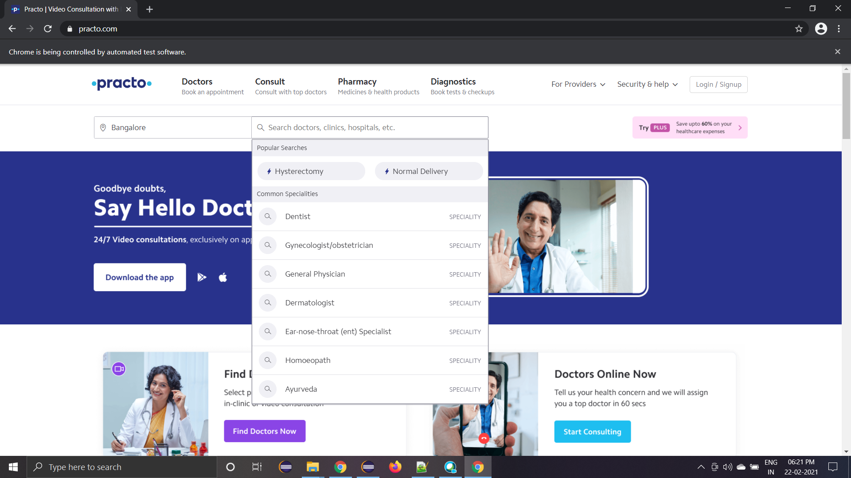
BANGALORE LOCATION SELECTED

Slide 7
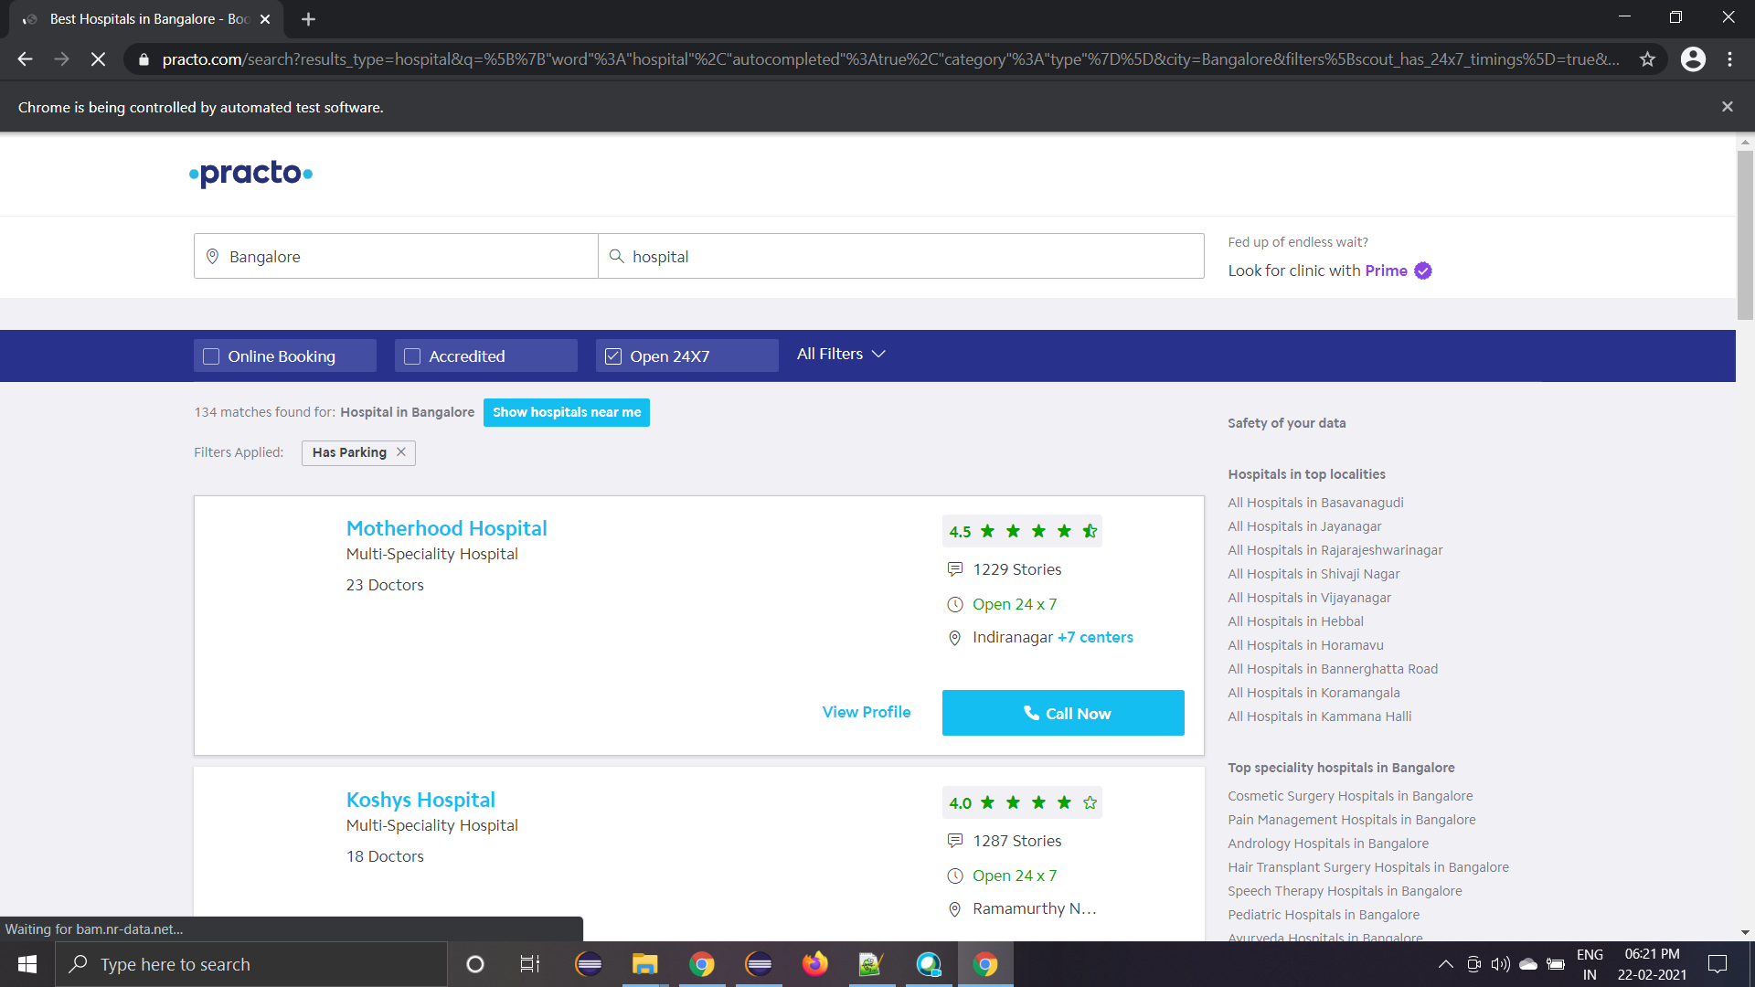
FINDING HOSPITALS

Slide 8
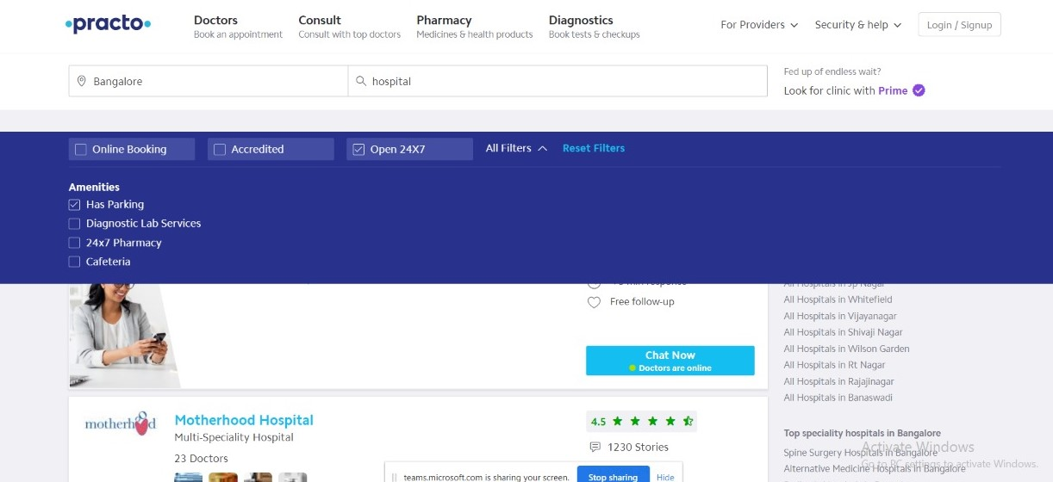
SELECTING THE FEATURE “OPEN 24/7” AND “HAS PARKING”

Slide 9
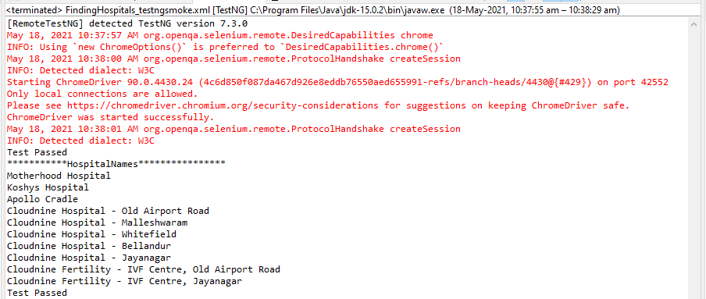
Displaying Hospitals Names

Slide 10
Second Description
In Diagnostics page, pick all the top cities name & store in a List; Display the same
Go to www.practo.com
Click Diagnostics button
Pick all the top cities name & store in a List
Display the cities

Slide 11
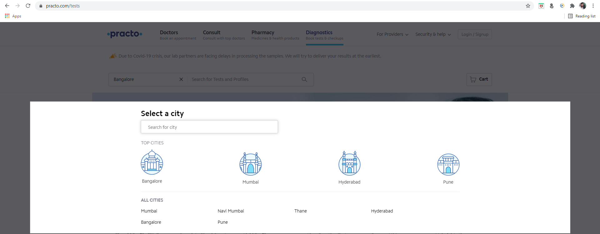
Displaying Top Cities

Slide 12
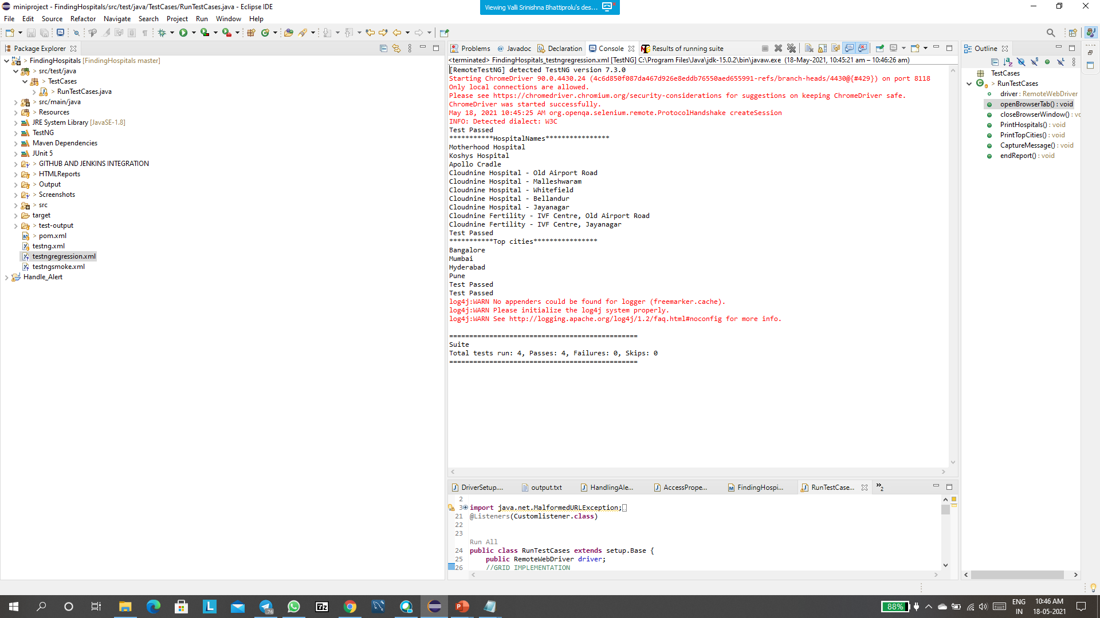
Displaying Top Cities names in console

Slide 13
Third Description
Go to Corporate Wellness, fill invalid details, schedule & capture the warning message from the alert
Click on For Providers then go to Corporate Wellness.
Enter name in the provided text field.
Enter the Organization name in the provided text field.
Enter Official email-id in the provided text field.
Enter contact number in the provided text field.
Handle the alert box.

Slide 14
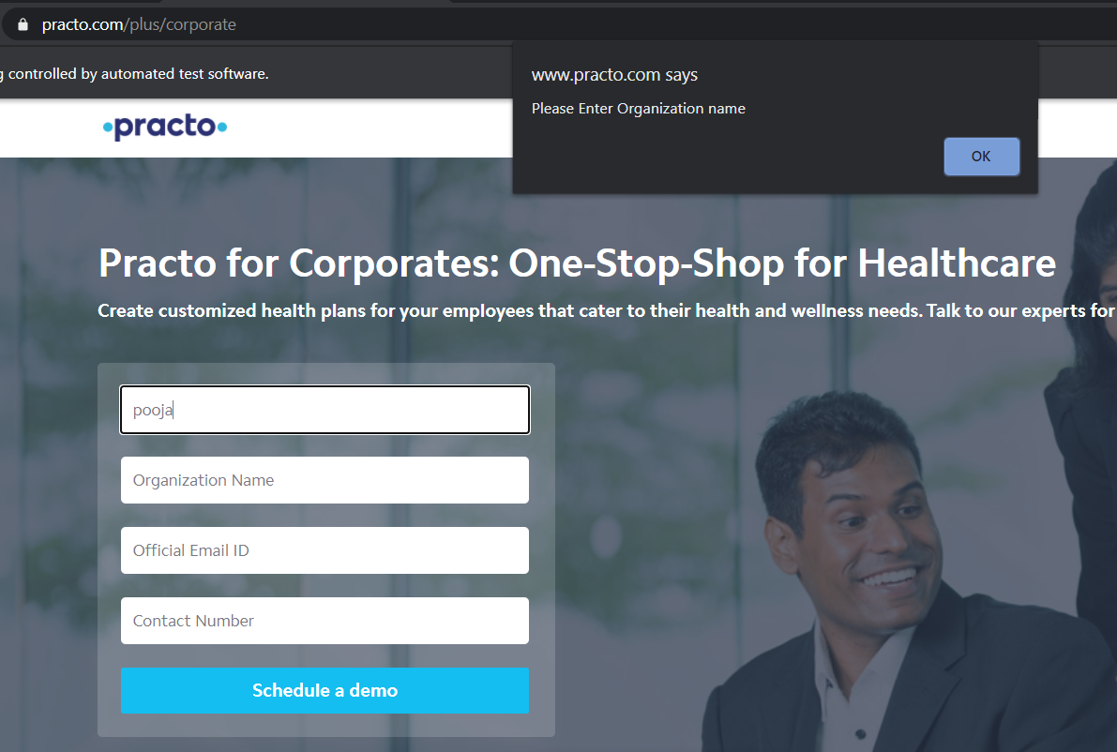
CASE 1:
Entering name and keeping all other text field empty to capture the alert box.

Slide 15
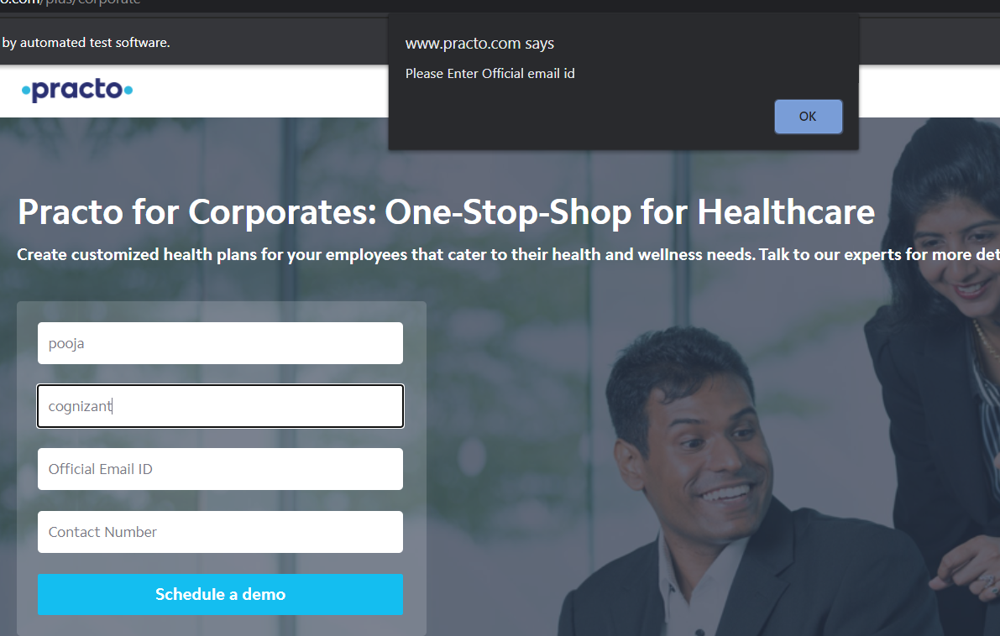
CASE 2:
Entering name, organization name and keeping other text field empty to handle alert box.

Slide 16
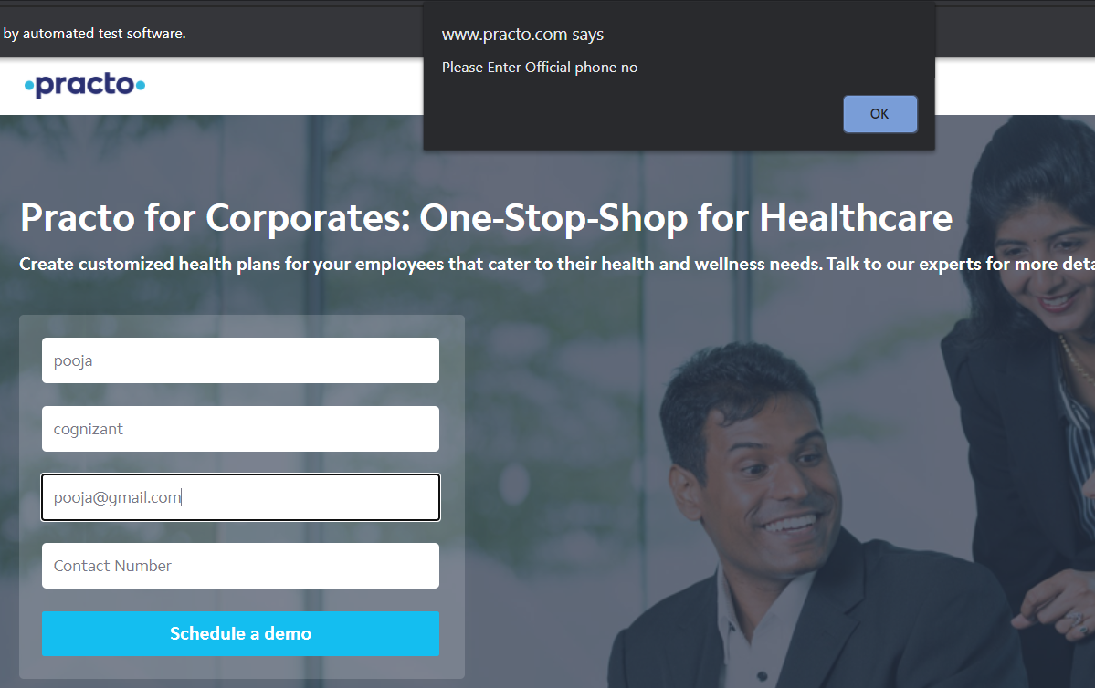
CASE 3:
Entering name, organization name, email id and keeping phone number text field empty to handle the alert box.

Slide 17
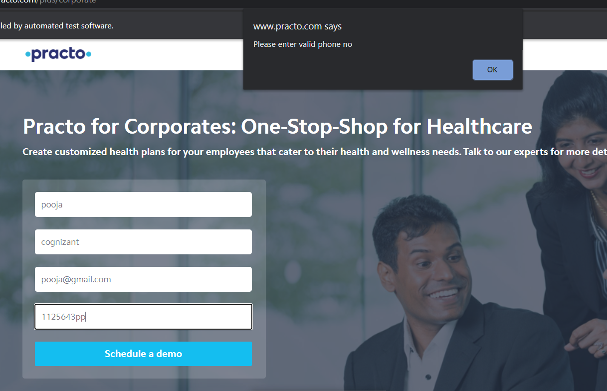
CASE 4:
Entering invalid phone number to handle the alert box.

Slide 18
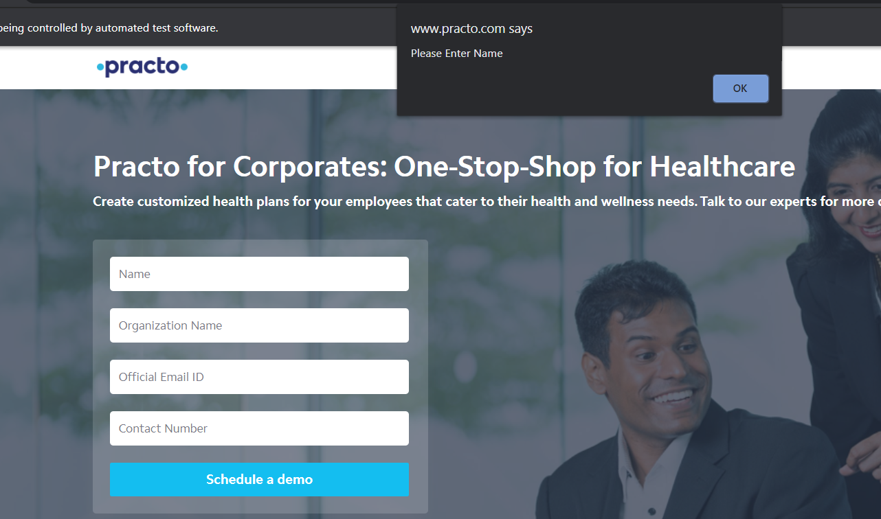
CASE 5:
Keeping all the text field empty and clicking on “Schedule a demo” to handle alert box.

Slide 19
Console Output

Slide 20
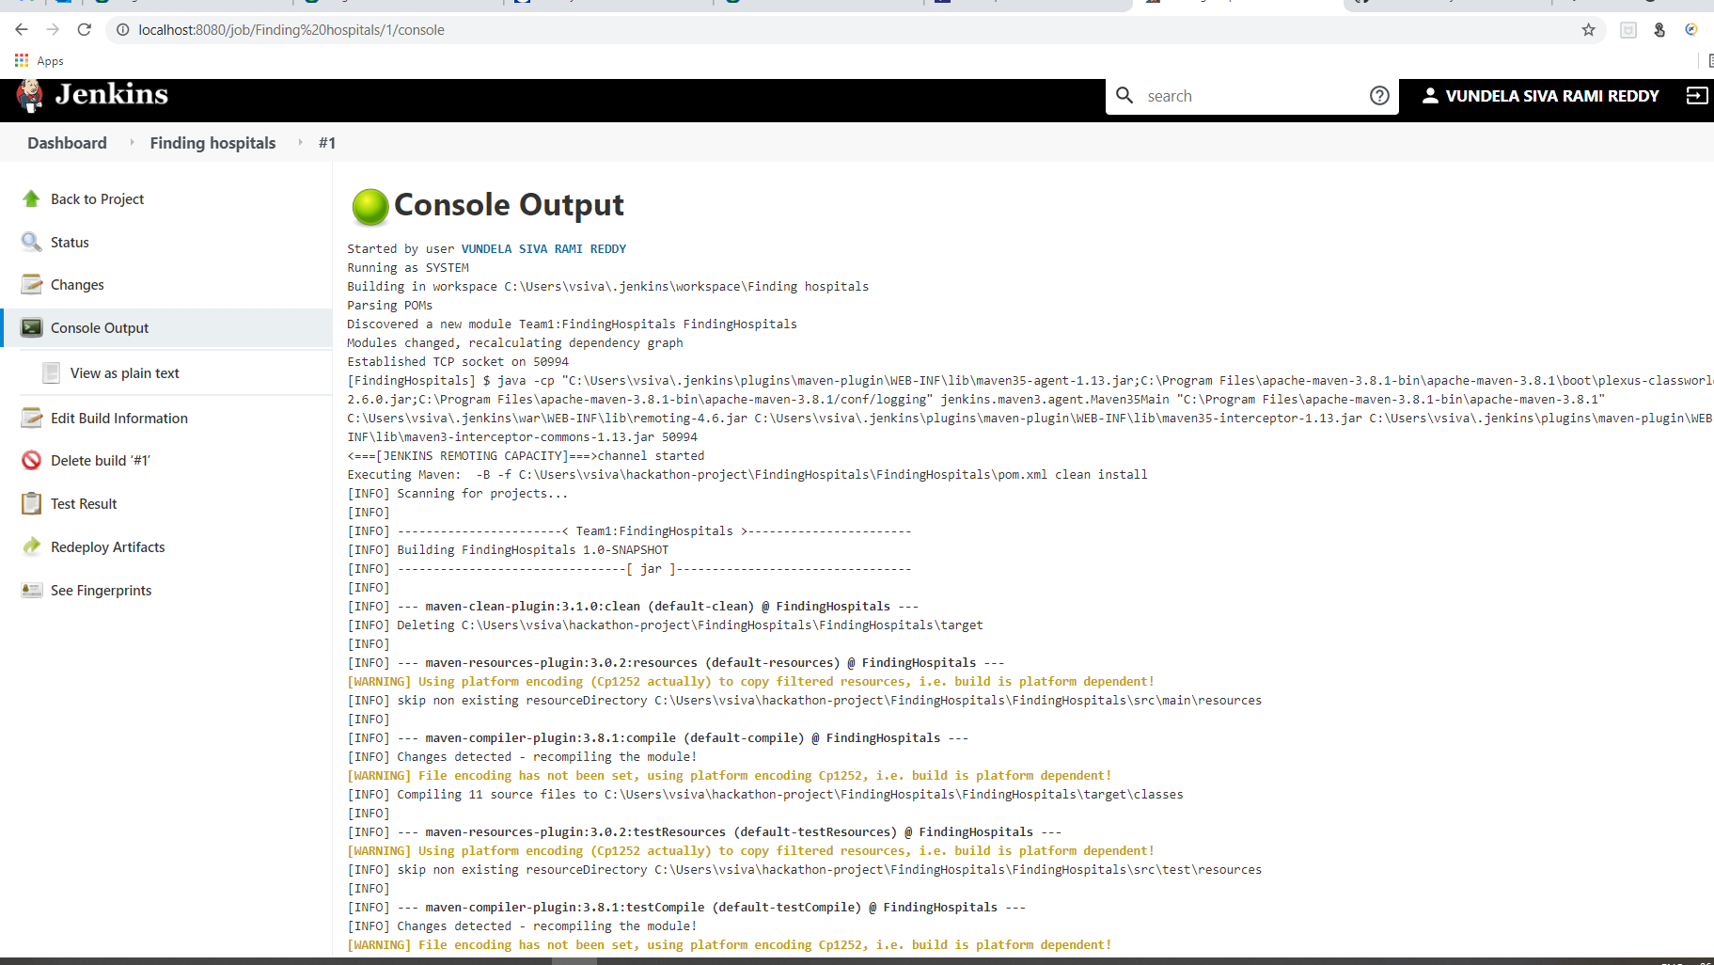
Jenkins Output

Slide 21
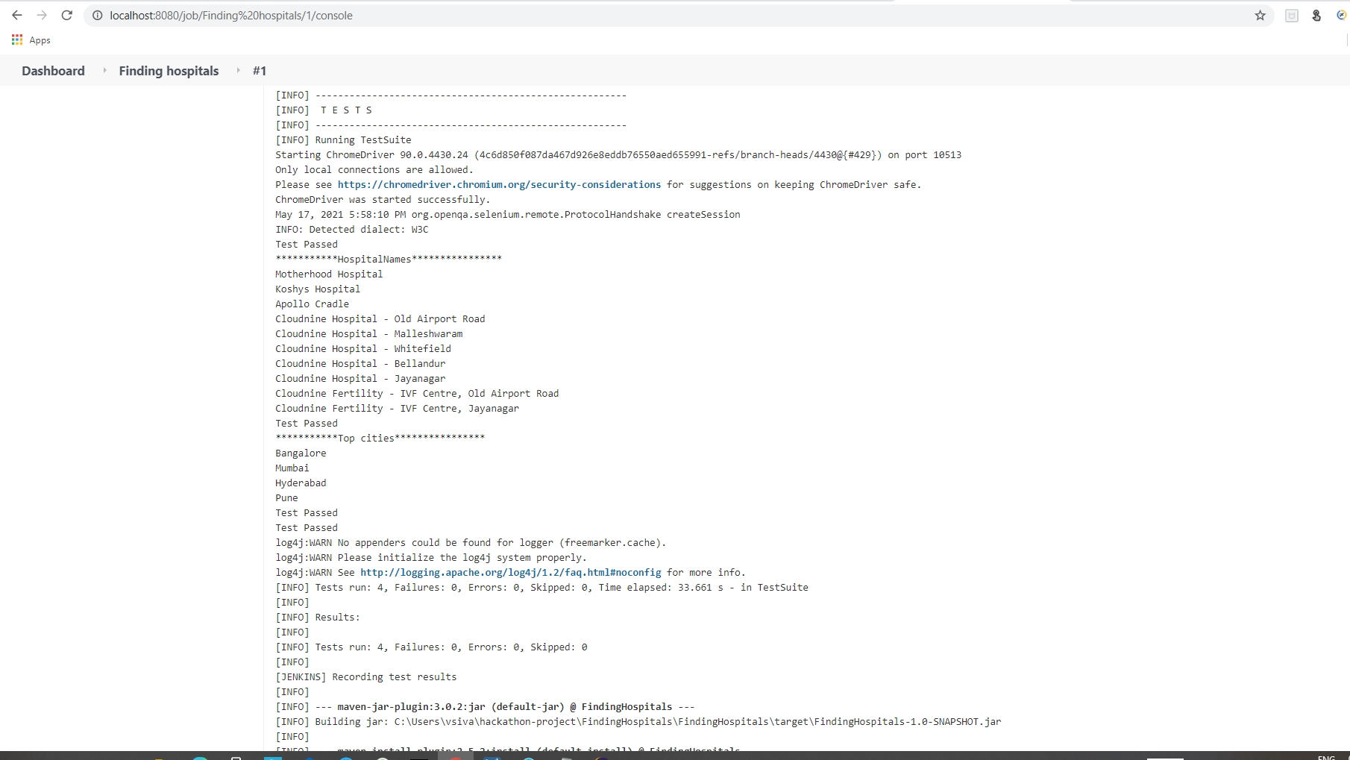
Jenkins Output

Slide 22
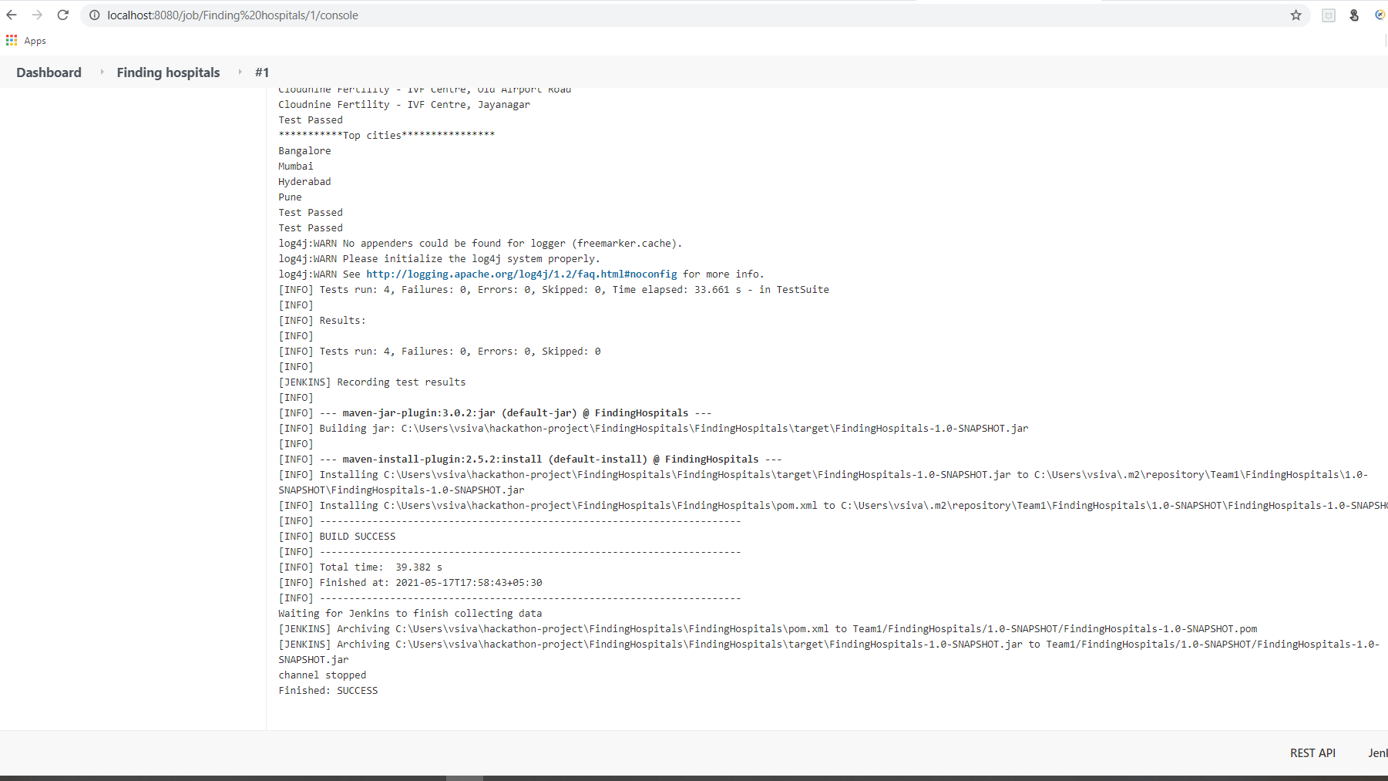
Jenkins Output

Slide 23
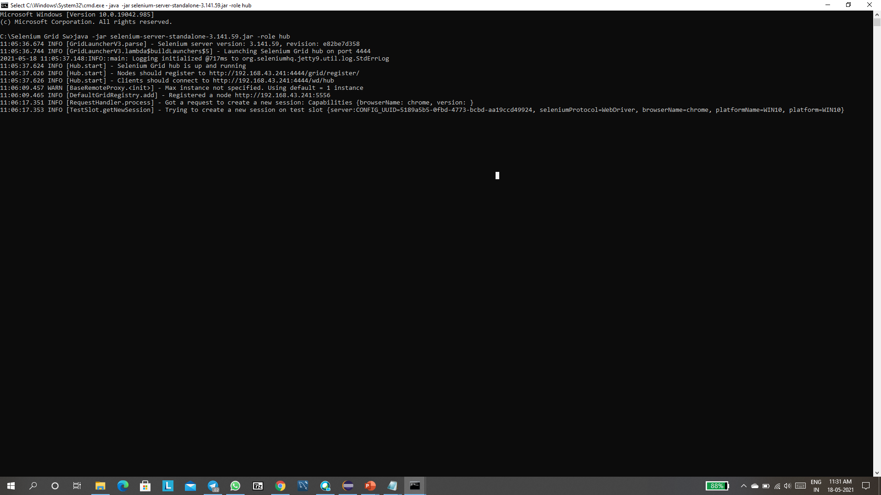
Grid Implementation:

Slide 24
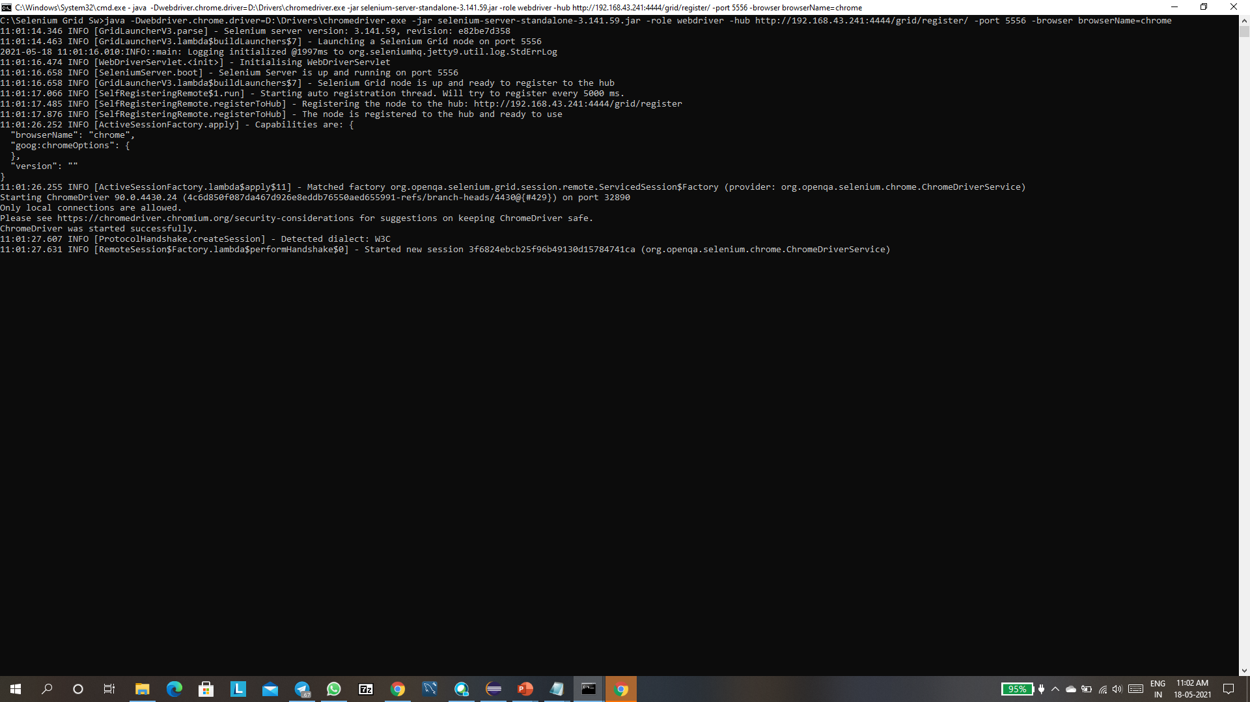
Created a node:

Slide 25
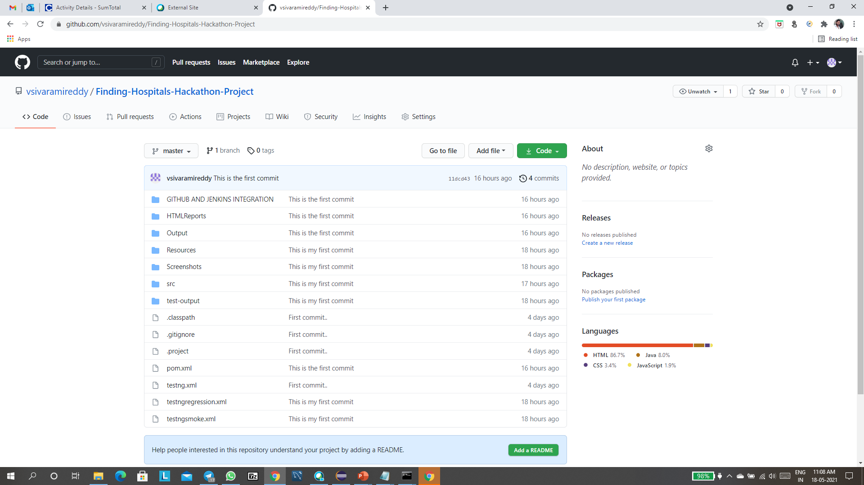
Git Implementation:

Slide 26
THANK YOU

